Slide 1
Credit Risk: ML default prediction algorithm
Ironhack Berlin
Data Analytics Final Presentaion
Silviu Sica

Slide 2



Lending Process
Retail Borrower
Risk Assessment
Outcome
$$$
Notes:
Credit risk is an assessment of the likelihood that a borrower, corporate or individual, may not pay back the money loaned. The process starts with the prospective borrower making a loan application, while the bank analyzes the data gathered and assigns a quality score to a loan based on the borrower’s credit history, quality of collateral and the likelihood of repayment the loan principal and the interest. Until the full loan reimbursement, the bank is exposed to default risk (borrower will not make the payment in due time).

Slide 3

How to predict the default of a borrower?
Loan Risk Factors Dataset
ML Prediction
Expectations
Age | +
Income | +
Home ownership | +
Employment length | +
Loan intent | Depends
Rating | +
Loan amount | -
Interest rate | -
Debt to income | -
Payment delinquencies | -
Credit history length | +
Notes:
The challenge is to predict whether the loan will default or not based on the data features available. Given the following 11 risk factors, we can assume beforehand the relationship of each of these categories and the loan quality. A higher income, older age, home ownership, employment length, good rating and a longer credit history length have a positive relationship with non-default, whereas a higher loan amount, higher interest rate, a significant debt-to-income and previous payment failures will have a negative relationship with less default risk.
BREAK POINT - ANIMATION
Credit bureau data for over 32,000 loans is used for the ML predicitions, upon data pre-processing, feature selection, data split and model building. So I am estimating the probability of default based on the 11 risk categories.

Slide 4
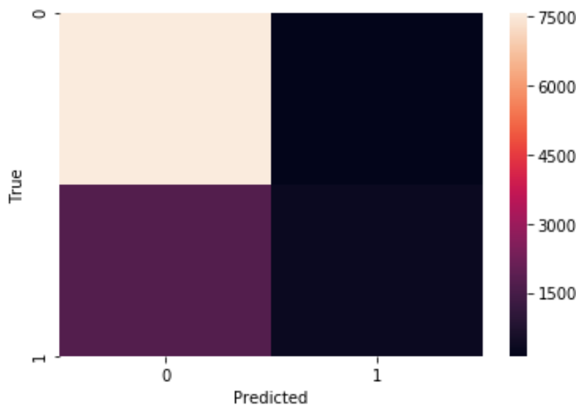
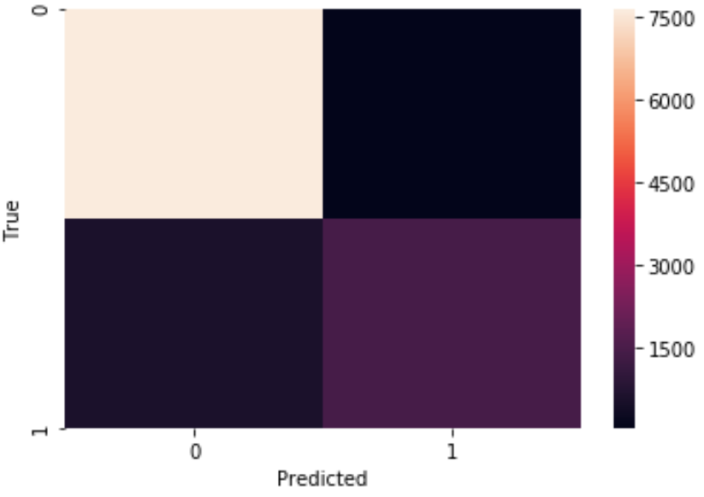
ML Results
Model 1: Logistics Regression
Model 2: Random Forrest
TP: 98%
TP: 99%
TN: 16%
TN: 70%
Accuracy: 81%
Accuracy: 93%
Notes:
Let’s look at the performance of the models used. Under Logistics regression, an 81% accuracy level of the predicted values was obtained, however the true negative proportion was quite low, meaning if the bank would run this model it would identify only 16% of the actual defaults. I tried to apply a different model to improve the true negatives.
BREAKPOINT – ANIMATION
Decision tree techinques have gained momentum in credit modelling for learning and classification. The Random Forrest combines predictions of decision trees, and outputting the mean prediction (regression) of individual trees. For our aim of predicting the default probability, the Random Forrest model reduces the false negative, unidentified defaults and improves overall accuracy.

Slide 5

Who will default?
 | Andy | Ilse
Age | 30 | 29
Income | 65,000 | 55,000
Home ownership | Rent | Owner
Employment length | 1 year | > 1 year
Loan intent | Venture | Home improvement
Amount | 35,000 | 15,000
Interest rate | 3.95% | 2.75%
Debt to income | 53% | 27%
Payment delinquencies | Yes | No
Credit history length | 3 years | 1 year
Rating | B | C
Notes:
Let’s make some predictions! We take two random characters, Andy and Ilse, with comparable ages, income and rating. Andy needs a loan to open a music record label venture, while Ilse is looking to make some improvement to her home. As per their intent, the loan amount is significantly higher for Andy, him incurring also a higher interest rate given a previous overdue loan payment.
BREAKPOINT - ANIMATION
Based on these loan characteristics, let’s see if they will default or not.

Slide 6
Default prediction
Andy: Yes / Ilse: No
Model 1
Model 2
Ranking | Risk coefficients importance
1. | Loan amount | +
2. | Income | (-)
Ranking | Risk coefficients importance
1. | Debt to income
2. | Income
3. | Interest rate
4. | Loan amount
Notes:
Based on both models, Andy is defaulting and Ilse is not. My initial guess was that this is due to Andy having previous bad credit/ payment delinquencies, but the coefficients which had the most significant impact were the “Loan amount” and “Income” under the first model, we remember Andy’s loan was over twice the size of Ilse’s loan, with less dispersed income levels.
Based on the second model, the high proportion of debt to income, income level, interest rate and loan amount are the most important coefficients for the default prediction, and here we remember that Andy had a higher Loan Amount which increased his debt to income and also a higher interest rate due to his past bad credit file.

Slide 7
Further developments
Analyze model variability (over-optimization)
Handling imbalanced dataset (default feature)
Using neural network ensembles for bankruptcy prediction and credit scoring
Benchmarking classification algorithms for credit scoring
Notes:
For further use of the project I would like to analyze the variability of the model, varying the data in the model according to demographics. Further optimization would be handling the imbalanced dataset, undersampling and oversampling to better fit the classifier.

Slide 8
Thank you very much!

